Slide 1
Hospital Management System
An Overview of the System and Its Key Features
Group Members:-
1.Soumya ranjan parida-2201020282
2.Sundeep Nayak-2201020679
3.Priyanshu sekhar Bhuyan-2201020468
4. Prem keshariSahoo-2201020638
5. Md Ayaan 2201020312

Slide 2
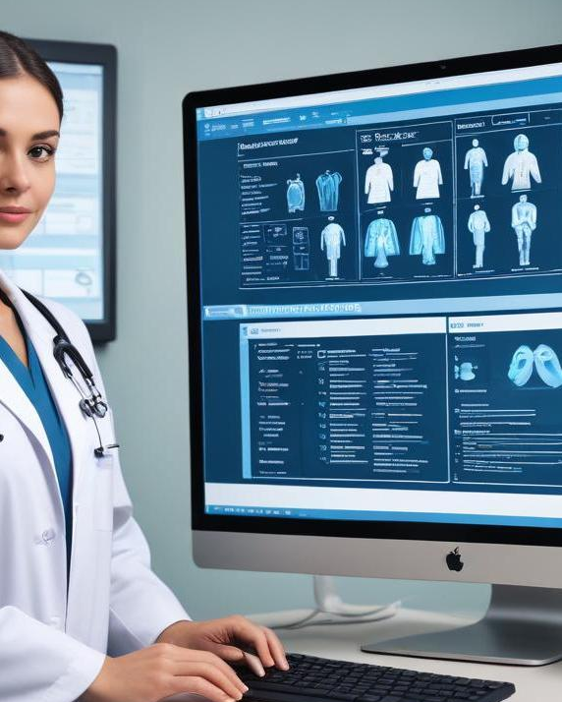
Introduction
This presentation delves into the Hospital Management System, exploring its definition, primary features, and significance in healthcare environments.

Slide 3
01
Overview

Slide 4
Definition of Hospital Management System
A Hospital Management System (HMS) is an integrated software solution designed to streamline various administrative and clinical functions of a hospital. It helps manage patient information, staff assignments, billing, and scheduling, ultimately ensuring efficient hospital operation.

Slide 5
Key Features
Key features of a Hospital Management System include patient management, appointment scheduling, billing integration, electronic health records, and reporting capabilities. These features work together to enhance the quality and efficiency of patient care and streamline workflows.

Slide 6

Importance in Healthcare
Hospital Management Systems are critical for modern healthcare organizations. They enhance the efficiency of patient care, reduce errors, and ensure better communication among healthcare providers. By automating administrative tasks and providing real-time data access, HMS contribute to improved patient outcomes and streamlined operations, ultimately leading to healthier communities.

Slide 7
02
Components

Slide 8
Patient Management
Patient management modules in a Hospital Management System assist in maintaining comprehensive patient records, scheduling appointments, and managing patient histories. These tools facilitate efficient workflows, improve patient satisfaction, and help healthcare providers deliver more personalized care. Automation in this area decreases waiting times and enhances service delivery.

Slide 9
Staff Management
Staff management is a vital component of a Hospital Management System that includes modules for scheduling shifts, tracking attendance, and managing payroll. By streamlining these processes, hospitals can ensure adequate staff coverage and reduce administrative burdens, allowing staff to focus on patient care rather than paperwork, thus enhancing overall productivity.

Slide 10
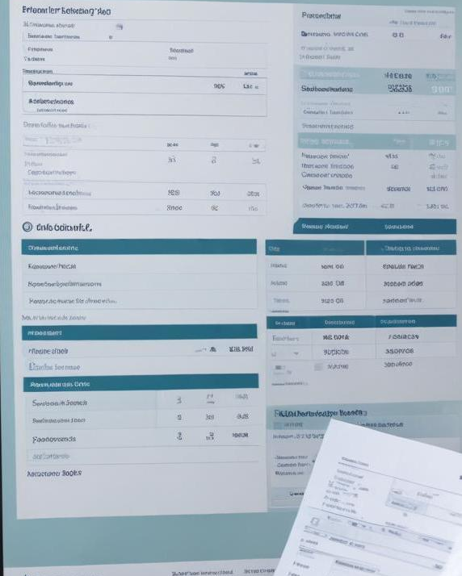
Billing and Accounting
Billing and accounting modules are essential for managing hospital finances. These systems handle patient billing, insurance claims, and financial reporting, ensuring accuracy and compliance with regulations. They help reduce billing errors, enable faster reimbursements, and provide clear financial insights, thus supporting better financial management and sustainability of the hospital.

Slide 11

Conclusions
Implementing a Hospital Management System is crucial for enhancing healthcare service efficiency. It brings together various operational aspects – from patient care to billing, fostering a cohesive environment that improves healthcare delivery. The integration of technology in hospital management not only optimizes workflows but also ensures a higher standard of patient safety and satisfaction.

Slide 12
Thank you!

